Slide 1
SHIVOOG
Your watchful third eye
Mukul Samant
mukuldms7@gmail.com
+91 7768993767
Dattaprasad Ekavade
ekavade@gmail.com
+91 7972242076

Slide 2
Problem
Everyone want to protect their loved ones, keep an eye on them, know that they are safe.
Parents need a peace of mind knowing where their kids are at all times hassle-free.
There is an exponential increase in child kidnappings in India

Slide 3
Unique Value Proposition
Peace of mind to knowing were their kids are at all times.
Convenient school friendly device.
Accurate tracking info through use of Blockchain Technology
Secure data storage using Blockchain Technology
Trace real-time hassle free for kids and loved ones.
You decide who knows Your location data.

Slide 4
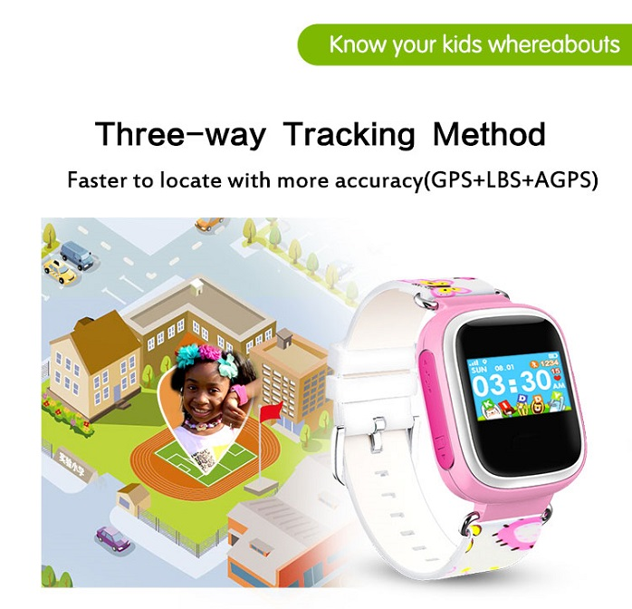
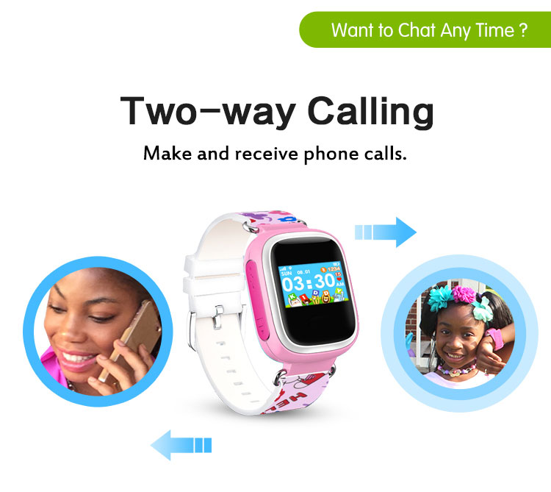

Underlying Magic
Three way tracking Using GPS+LBS+AGPS
Two way voice chat: Receive and Make calls from watch
Secure Tracking data using Blockchain Technology

Slide 5

Business Model
asdadsadf

Slide 6
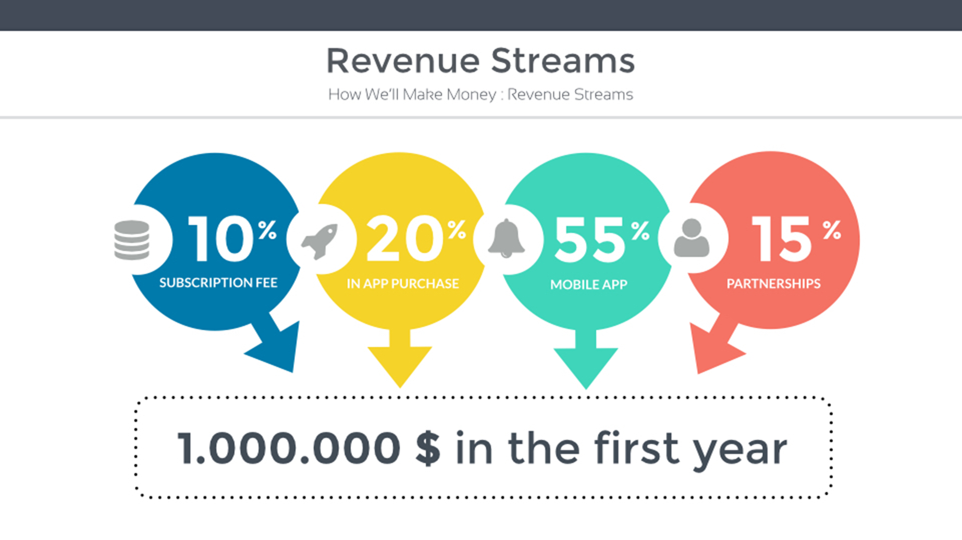
asdadsadf

Slide 7
Go-To-Market Plan
asdadsadf

Slide 8
asdadsadf

Slide 9
asdadsadf

Slide 10
asdadsadf

